Slide 1
High Voltage Engineering (E 1530)
Dr/Tarek Abd-Elhamid Dakrory

Slide 2
Measurements of HV (DC, AC, and impulse voltage)

Slide 3
Sphere Gaps 1-Horizental 2- vertical

Slide 4
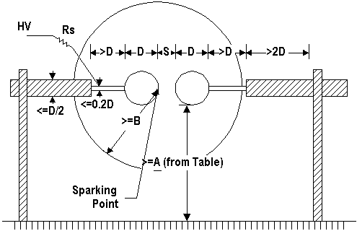
Horizontal

Slide 5
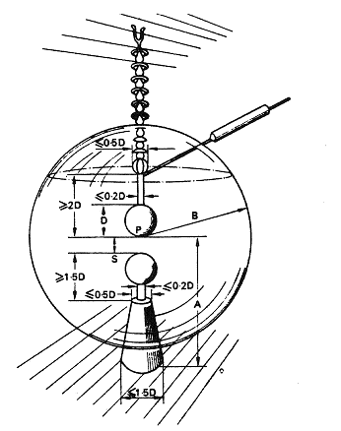
Sphere gaps

Slide 6
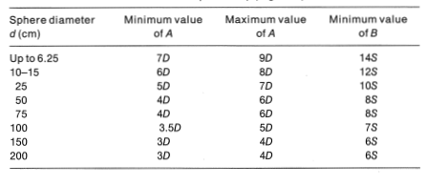
Table 1

Slide 7
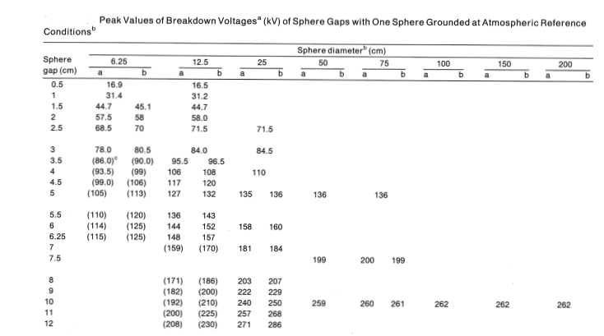
Table 2

Slide 8
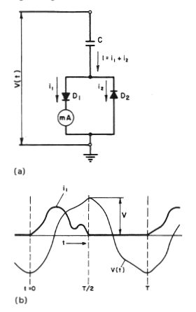
Peak voltmeter

Slide 9
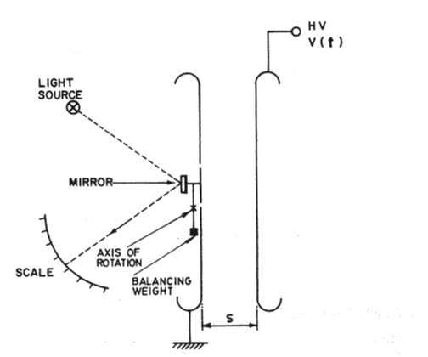
Electrostatic voltmeter

